Slide 1
How to increase revenue IN RIO?
Deep diving into the analysis of specific customer regions

Slide 2
Pareto Principle
The focus should be on 20% customers, generating 80% of total revenue.
Product Reviews
Reviews can help to identify customer states that do not match the trends
Problematic States
We will see which products generate most (average) revenue in those problematic states, and which have the lowest ratings
CUSTOMER SEGMENTATION
RFM analysis helps to identify which customer segments can benefit from further actions

Slide 3
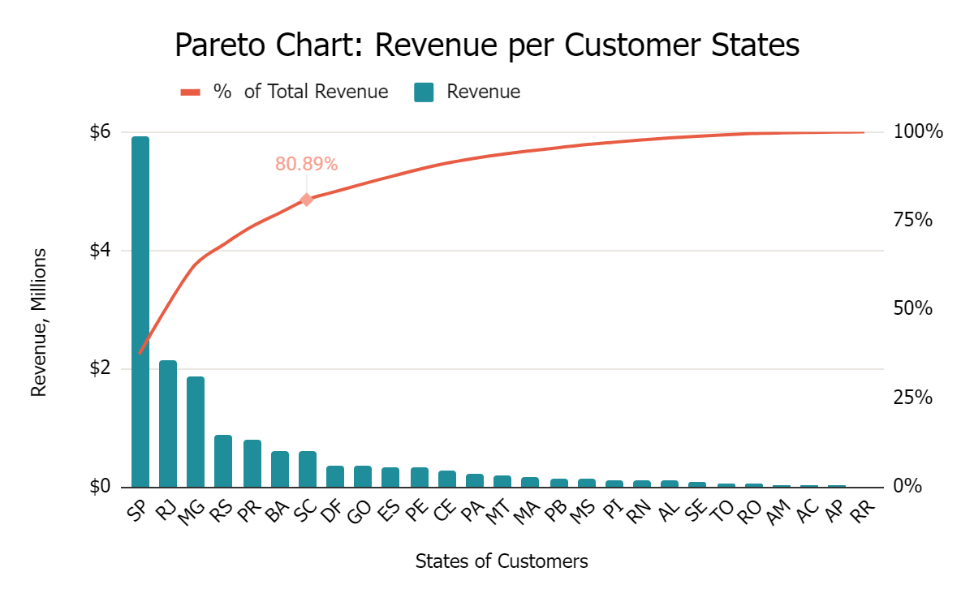
The focus should be on 20% customers, generating 80% of total revenue: it should include only 5 states, but it does 7. Some of the first 5 could generate more revenue in theory, and also are the where our interest lies

Slide 4
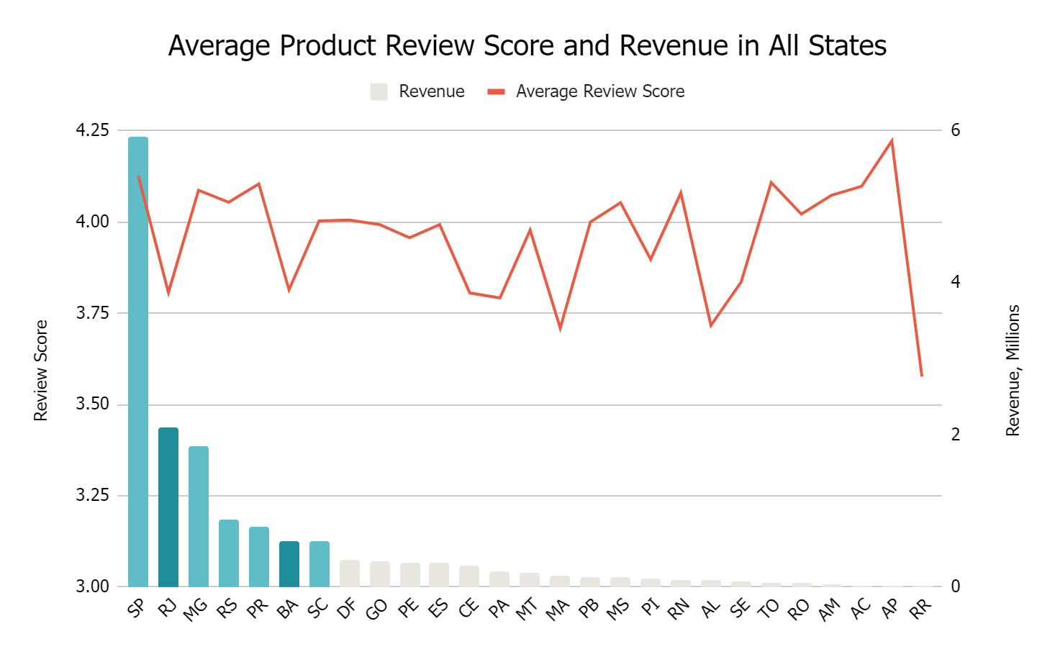
The average review score in all states is 4.04 (even more in the leader Sao Paulo). There is a sharp drop in Rio de Janeiro (RJ) and Bahia (BA).

Slide 5
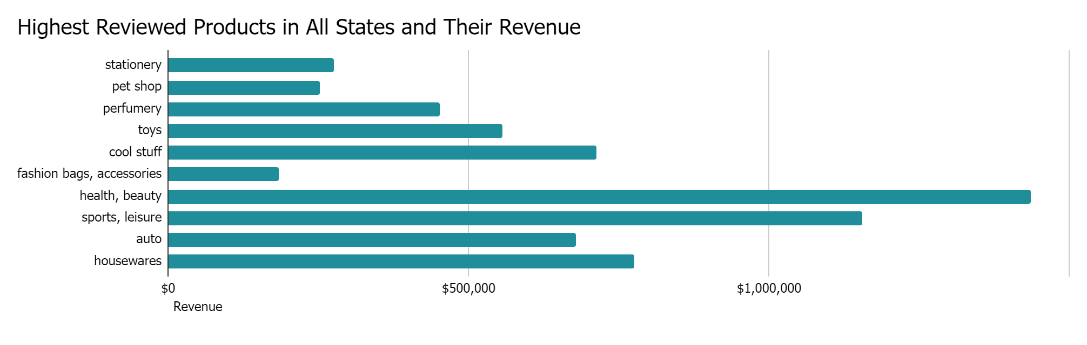
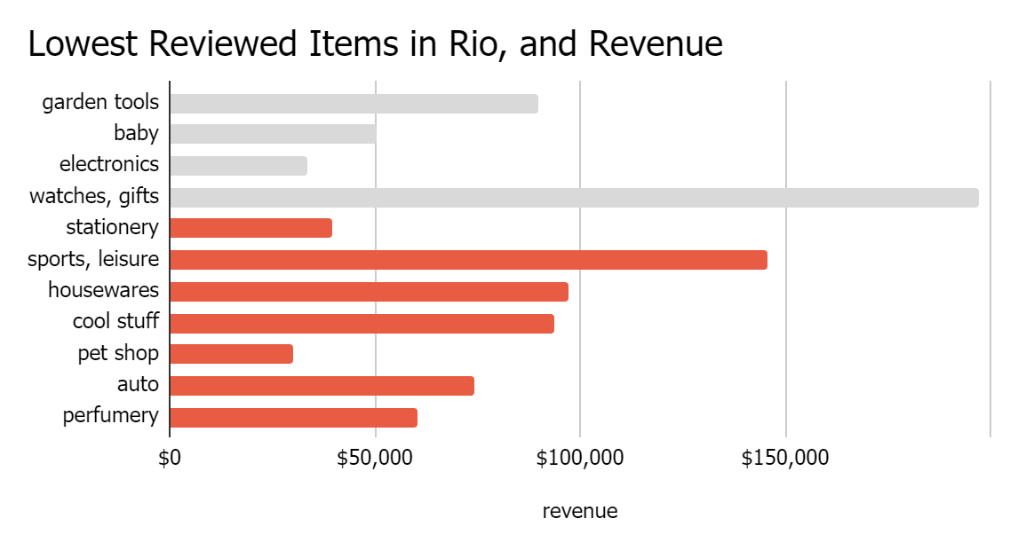
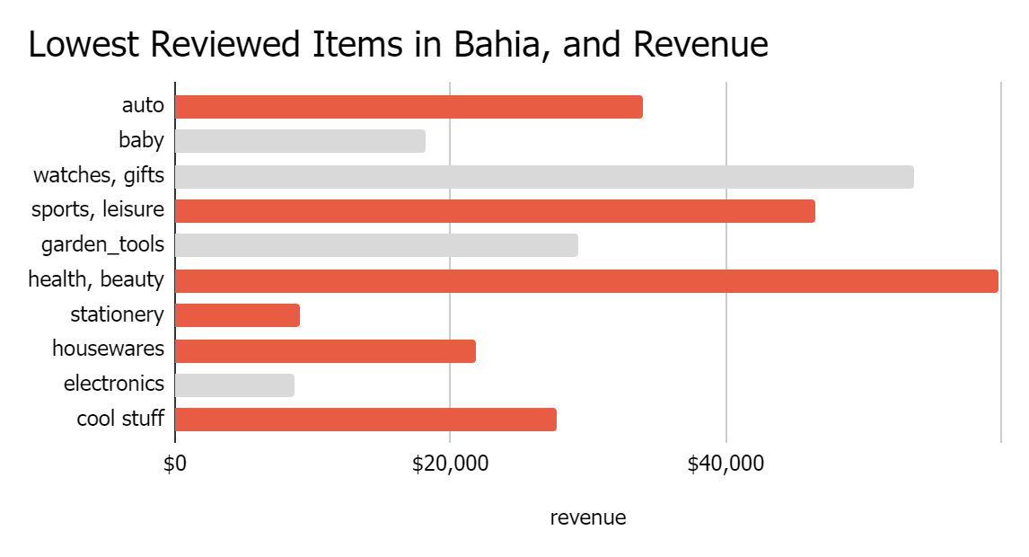
Includes only categories with 1500 reviews (total avg) or more
Some of the lowest reviewed product categories in Rio and Bahia (colored) are also the highest reviewed overall in all the states. These require special attention, especially in Rio as the revenue is higher for categories.
Includes only categories with 209 reviews (Rio avg) or more
Includes only categories with 59 reviews (Bahia avg) or more

Slide 6
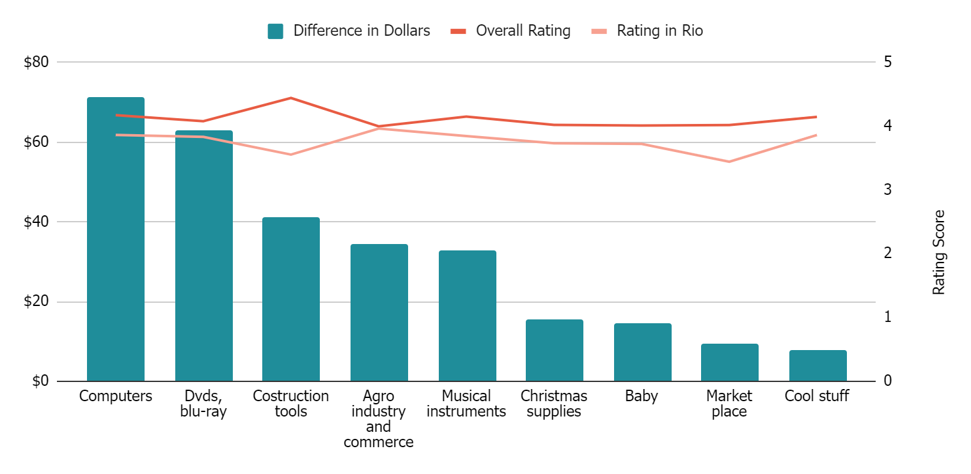
Rio Products with Biggest Difference in Dollars from Average in All States
$204,097
These product categories have a higher average total rating than rating in Rio and have a sharp difference in their order value. They could benefit from higher rating score
Total Revenue
$191
AOV

Slide 7
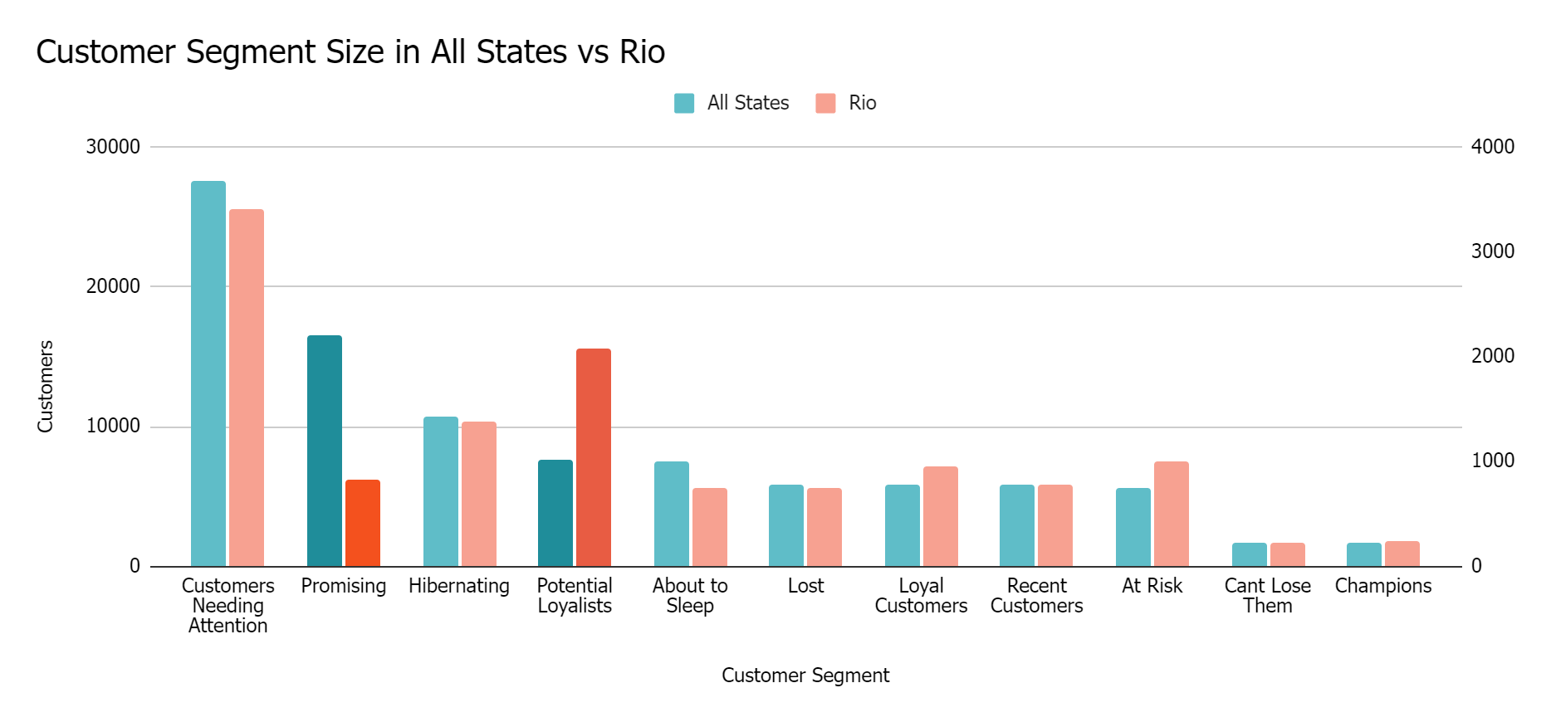
Rio De Janeiro has a smaller Promising (quite recent users that did not spend much yet) customer segment, and a bigger Potential Loyalist (quite recent users that spend decent amount) segment.
We could engage them better (offers, loyalty programs, recommending different products)

Slide 8
ACTIONABLE INSIGHTS
PARETO WORKS
LOW REVIEWS IN RIO AND BAHIA
5-7 customers states generates 80% of the revenue. Our focus should be on them.
In those revenue generating states, Rio de Janeiro and Bahia have lower review rating. We should focus on these states in particular.
CERTAIN CATEGORIES
USER SEGMENTS
Some of the categories have a sharp difference in their review score and average order value. They should be investigated, especially the ones in Rio as they have a high revenue
Offer loyalty program, recommend other products for Potential Loyalists, and create better brand awareness, offer sales for Promising users.

Slide 9
THANK YOU

